Slide 1
Государсвтенно правовое регулирование недропользования
1 Понятие, роль и место государства в регулировании отношений в сфере недропользования
2 Государственно правовое регулирование налогоблажения недропользователей и вопросы обеспечения стабильности налоговоых режимов

Slide 2
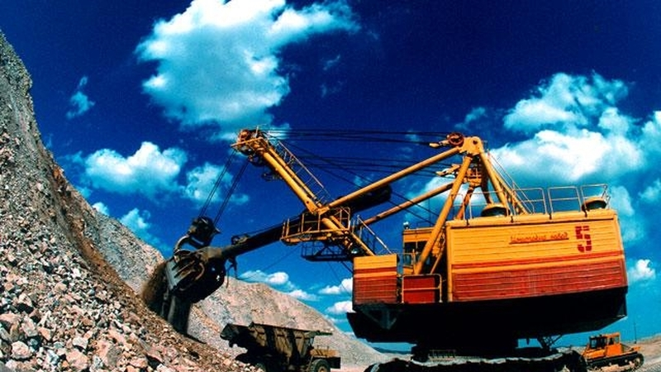

Slide 3
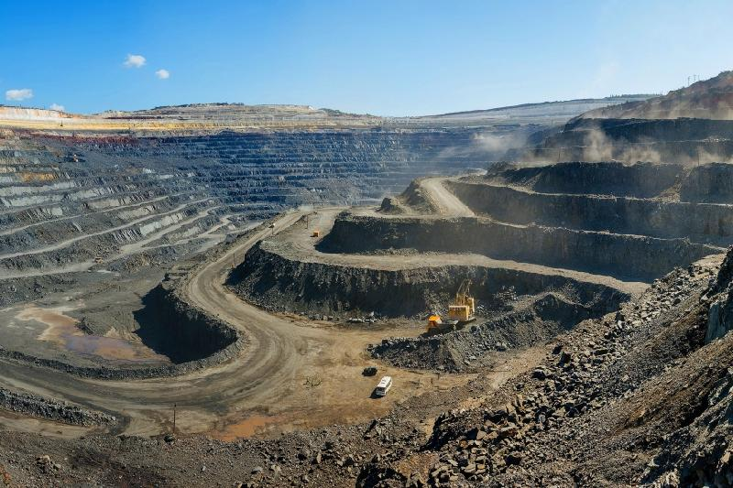

Slide 4
It is generally recognized that the state is a complex and historically developing socio-political phenomenon. Questions about the state, its concept, essence and role in society at all times were among the most controversial, both in state studies and in law. Born of society and its contradictions, the state itself inevitably carries elements of contradiction, its activities and social role are contradictory. As a form of organization of society, designed to ensure its integrity and manageability, the state performs functions determined by the needs of society. Sometimes the state acts as a sovereign, representing and protecting national and public interests, and sometimes enters into civil law relations as an equal subject of relations. Therefore, the state, while ensuring the rule of law in society, must also ensure the legality of its multi-faceted activities. A. A. Matyukhin, asking the question: "why is the activity of the state itself recognized as legitimate?", answers: "due to the fact that the state establishes responsibility before the law (by-law) not only for individuals, public and political institutions, but also for itself." It appears "as an institution that restricts itself to law, acting within the framework of law»

Slide 5
Historically, before the collapse of the USSR, subsoil use as a sphere of anthropogenic activity was in the hands of the state. In the first half of the 90s of the last century, with the transition to the liberal-conservative doctrines of political and economic development (Kazakhstan did not have the classical development of democracy and market economic relations), subsurface use objects (subsurface areas, mineral deposits, infrastructure, etc.) began to be managed by private companies, including foreign ones. Private subsurface users were assigned the functions of economic management, investment, geological exploration, field development, mining and processing of mineral raw materials. The private sector, with limited participation of state economic entities, was given the rights to use the subsoil and dispose of minerals and other mineral resources.

Slide 6
Thus, private economic entities, including those with the participation of foreign companies, as business partners of the state, received administrative and economic freedom on subsurface use objects that are the property of the state, as well as the right to appropriate profits. The state has reserved regulatory and control functions, in particular, to establish conditions for the use of mineral resources and monitor their implementation by subsoil users.

Slide 7
Currently, in accordance with the applicable Law of Kazakhstan "On subsoil and subsoil use" the system of state management of mineral resources and the system of state control over the activities of subsoil users provides the following structure of the authorized state bodies: government of the Republic of Kazakhstan (article 7); the competent authority for subsoil use (article 8); the authorized body for study and utilization of mineral resources (article 8-1); the authorized body in the field of environmental protection (article 8-2); authorized body in the field of trade regulation and industrial policy (article 8-3, paragraph 1); authorized body coordinating the implementation of state employment policy (article 8-3, paragraph 2); regional and equivalent Executive bodies (article 9).
A special role in this system is played by the national company KazMunayGas, which is involved in the development of the subsoil of Kazakhstan. The competence of this state economic entity in the field of subsurface use will be considered in the following subsections of this work.

Slide 8
It is difficult to call such a complex structure of authorized state bodies exercising administrative and power powers in the field of subsurface use perfect and effective. The number of agencies involved does not ensure the proper quality of state regulation of relations in this important area of the country's economy. During the recent history of Kazakhstan, this structure has changed many times, but these changes did not lead to the expected improvement, but on the contrary caused many conflicts between the state and subsoil users. The existing structure needs to be optimized as an incentive to increase the efficiency and effectiveness of state control over the activities of subsoil users, while maintaining a balance between the administrative and power powers of authorized state bodies and private law methods and mechanisms for regulating relations in the field of subsoil use

Slide 9
In our opinion, the following can be excluded from the list of authorized bodies for subsoil use without prejudice to the case: the authorized body for the study and use of mineral resources; the authorized body in the field of environmental protection; the authorized body in the field of trade regulation and industrial policy; the authorized body coordinating the implementation of state policy in the field of employment. At the same time, the powers of the first two state bodies should be included in the function of the competent authority, and the powers of the last two state bodies are not peculiar to the sphere of subsurface use at all. If we analyze the history of development of legislation on subsoil and subsoil use, the authorized bodies were included in a special legal act regulating relations in subsoil Law of the RK of October 14, 2005 No. 79, which was, primarily, an indicator of the internal struggle for influence in this important sector of the economy. Further law enforcement practice has shown the complete failure of these legislative changes. In the current situation, on the contrary, it is necessary to strengthen the role and expand the functions of the competent authority, and not limit its powers only to issues related to the conclusion and execution of subsurface use contracts. In order to increase the role of the competent authority in regulating relations in the field of subsoil use, it is proposed to exclude articles 8-1, 8-2 and 8-3 from the current law of the Republic of Kazakhstan "On subsoil and subsoil use".

Slide 10
The legal literature defines the role and place of the state in regulating economic relations in different ways. Thus, it is very interesting and detailed formulated the role of the state in regulating relations in the field of subsurface use L. N. Nursultanova with reference to the theoretical developments of S. Z. Zimanov, who in her opinion "worked out in detail the role of the state in contractual relations with foreign investors in the oil sector", in particular, she cited the following provisions expressed by S. Z. Zimanov that:
- "the state, represented by the competent authority of the Republic of Kazakhstan, entering into a contract for subsoil use with investors, being an equal partner with the latter in contractual relations and bearing responsibility for the fulfillment of their conditions and stability, at the same time implements its constitutional and functional legal capacity as an expression of the interests of state security;
- the right of the state to acquire a part of shares or a share in a package of an oil field development project should be considered in the context of political and legal status and as the first right belonging to the state among equals in contractual relations;
- the state's claim to acquire a share in the project package offered for sale is its priority right under the law;
- in contractual relations in the oil industry, a permanent factor is to ensure a gradual balance between the interests of the state and investors;
- in contractual relations between the state and foreign investors, th

Slide 11
Formulated By L. N. Nursultanova based on the works of S. Z. Zemanova theoretical study are generally consistent with the conclusion made by S. Z. Semenovym that "the state in subsoil use contracts concluded with foreign investors, regardless of whether it owns or owns shares in the project package (stock), acts both as a party to these contracts and the special, peculiar only to him, the role of the media management functions and the guarantor of law in contract relations." Further, he notes that "no contract is above the state, and Vice versa, the state is the dominant, "master" in contractual relations for subsurface use. State intervention in them is carried out within the framework of legality, determined both by the specific terms of the contract and by the legal status of the state itself as a special subject in these relations»

Slide 12
The fact remains indisputable that the state fully remains the owner of mineral resources and has the right to determine special conditions for their use in the interests of the entire society. And as Y. G. basin noted, "in a public regulatory mandatory procedure, the state determines the possibilities and procedure for providing private subsoil users, the main terms of contracts, fiscal conditions for subsoil users, conditions for monitoring their activities, unilateral measures taken by the state to violate the public order of subsoil use, and much more»

Slide 13
It seems that in order to bring together the points of view on the place and role of the state in regulating relations in the field of subsurface use, it is necessary to fix the following provisions at the legislative level.First, based on the right of state ownership of mineral resources, when regulating relations in the field of subsoil use, absolute priority should be given to state and public interests. However, this priority should be based on the legislative acts of Kazakhstan in order to ensure a balance between public and private law principles. Violation of this balance should be the subject of judicial protection.Secondly, it is necessary to clearly separate the competence of the state as a sovereign in public relations, and as an independent, equal subject in civil (private) relations.Third, the provision of subsurface areas (deposits) for use by subsurface users, regardless of whether national or foreign, should be carried out only on the basis of an open tender (tender) and by concluding a contract (agreement) according to the rules of civil legislation, while the specific conditions for conducting the tender, concluding and executing the contract should be prescribed in a special legislative act on subsurface and subsurface use.

Slide 14
Fourth, the main terms of the contract for subsurface use related to taxation and other mandatory payments must comply with the current tax legislation. At the same time, mandatory (public law) rules that provide for specific types and amounts of taxes and other mandatory payments cannot be automatically transferred to the contract. The subsurface use contract must include those types of mandatory payments that are generally specified in the tax legislation without specifying their amounts and rates, the procedure and conditions for payment. For example, article 287 of the previously existing Tax code established that "the bonuses are fixed payments of a subsurface user and are paid in monetary form in the amounts and manner prescribed in the contract for subsoil use". Or it was determined that the royalty rates are set individually in each subsurface use contract. While the current tax legislation contains an exhaustive list of tax and other mandatory payments, the procedure for determining their amounts and payment conditions, so there is no need to include special tax regimes in subsurface use contracts, as it was stipulated in previously concluded contracts.

Slide 15
Fifth, to ensure that the state needs of Kazakhstan are provided with strategic and scarce types of subsurface resources that determine the country's national security and ensure its sovereignty (strategic mineral resources, large deposits), it is necessary to allocate separate subsurface areas (used and unused) from the state subsurface Fund and give them the status of objects of strategic importance, including defining the Republican reserve Fund of deposits. In this regard, it should be noted that, at present, the government of the Republic of Kazakhstan has already defined a list of strategic subsurface areas (deposits) [106], however, it includes along with large subsurface areas that are really of strategic importance for the country's economy, and small subsurface areas, which, in turn, theoretically and practically devalued the significance of this legal act and the initiative to identify important state objects. Therefore, it is necessary to revise this list in the direction of reducing strategic subsurface areas (deposits) and include only those subsurface areas that are actually such, for example, the Tengiz and Kashagan oil fields, the Karachaganak gas condensate field, the Karaganda and Ekibastuz coal basins, large uranium and gold deposits, and a number of others.

Slide 16
Sixth, it is necessary to specify the role of the state in the geological study of subsurface resources, determine the principles and measures of economic and other incentives to attract investment in this type of subsurface use, replace the principle of reimbursement of historical expenses of the state for the search and evaluation of mineral deposits with the principle of acquiring from the state geological information necessary for the subsurface user for a specific section of subsurface resources (deposits). Perhaps the state should also abandon this type of mandatory payment, such as the commercial discovery bonus, which is paid by a subsurface user based on the results of exploration when mineral resources are discovered.
Seventh, the principles of supporting and stimulating the introduction of innovative technologies that increase the standards for extracting minerals and reduce their losses in the subsurface should be legislated. At the same time, it is necessary to introduce science-based criteria for high depletion of deposits, hard-to-recover reserves, and non-traditional types of mineral raw materials, and establish principles for economic and other incentives for their development.

Slide 17
Public administration always manifests itself as a social relationship that develops between the relevant state bodies and legal entities, as well as citizens about a particular good, in this case — the subsoil. It should be emphasized that state management of mineral resources does not mean that we are talking about management relations between state bodies and mineral resources. In the General theory of law, the legal regime is established not for things, but for the behavior of subjects related to them.Management is carried out through the interaction of certain elements of the system — the subject and the control object. The literature correctly draws attention to the fact that social management, as well as social and functional regulation, inevitably involves a continuous two-way interaction of two subsystems, one of which is the control, the other — the controlled

Slide 18
With regard to the subsoil controlled subsystem are the subsoil users physical or legal persons in accordance with current legislation on carrying out of subsoil use operations; the management subsystem corresponding state authorities, ministries, departments etc..Performing the function of state management in the sphere of subsoil use and subsoil protection, the state represented by its competent authorities establishes certain rules and regulations.

Slide 19
State regulation of subsurface use relations consists in creating legal, economic and organizational bases for integrated rational use and protection of subsurface resources. It is aimed at protecting the interests of the state and its citizens, as well as the rights of subsoil users.
The main functions of the state's subsurface management can be grouped into legal (legal regulation), economic (accounting, planning, logistics, economic incentives, standardization), organizational (work of management and control bodies, scientific research and training), spiritual and aesthetic (education and upbringing).Specific tools of state management in the sphere of subsoil use are:- in the field of legal regulation: creation of a regulatory framework; creation of a system for monitoring the implementation of legislation on mineral resources;- in the economic field: state planning; state investment; regulation of tariffs, benefits, quotas; creation of a standardization system;- in the organizational field: information and analytical support; structural reforms; support for competitive projects; training of personnel

Slide 20
Specific tools of state management in the sphere of subsoil use are:
- in the field of legal regulation: creation of a regulatory framework; creation of a system for monitoring the implementation of legislation on mineral resources;
- in the economic field: state planning; state investment; regulation of tariffs, benefits, quotas; creation of a standardization system;
- in the organizational field: information and analytical support; structural reforms; support for competitive projects; training of personnel

Slide 21
As shown by the long-term analysis of theoretical research, as well as the practice of state control and supervision in the field of subsurface use on the example of Kazakhstan, it is institutional changes that can ensure the effectiveness of state-legal regulation of subsurface use relations.Based on the importance of the sphere of subsoil use for the economy of Kazakhstan, state legal regulation should provide for the following priorities:
- sustainable provision of the country with mineral resources and products of their processing;
- improving the efficiency of the use of mineral resources and creating the necessary conditions for the transition of the economy to an energy-and resource
- saving path of development;
- development of the processing industry, maintaining and increasing the country's export potential, changing its structure in favor of trade in processed products;
- creation of effective legal and economic mechanisms for complex solution of problems of rational use, protection and reproduction of mineral resources;
- implementation of a reasonable combination and balance of administrative, legal and economic methods of state regulation in the field of subsurface use;
- formation of an effective system of state management and control bodies in the field of subsoil use;
- coordination and clear delineation of functions and competencies of authorized state bodies on subsoil use issues;
- development of the legal framework and formation of uniform law enforcement practice in order to stimulate innovation and investment processes in the field of subsurface use;- development of a unified mechanism for auditing the sphere of subsurface use.

Slide 22
The effectiveness of public-legal regulation of relations in the sphere of subsoil use shall be provided and the availability of peremptory norms in the law on subsoil and subsoil use, aimed primarily at:
1) ensuring the completeness of advanced geological study of subsoil for reliable estimate of size and structure of mineral reserves, deposits and subsoil, provided for operations on subsoil use;
2) ensuring rational and integrated use of subsurface resources at all stages of subsurface use operations;
3) ensuring the completeness of extraction of minerals from the subsurface, without allowing selective mining of rich areas;
4) ensuring reliable accounting of the extracted and left in the subsoil reserves of the main and jointly occurring minerals and associated elements, including products of processing of mineral raw materials and production waste during the development of deposits;
5) compliance with the established procedure for suspension, termination of operations on subsurface use, conservation and liquidation of subsurface development objects; and
6) ensuring environmental requirements in the development of mineral resources.

Slide 23
State-legal regulation of relations of subsurface use means state control over protection of mineral resources, which includes: a state monitoring of subsoil protection; monitoring of compliance with licensing and contractual terms relating to the field of protection of bowels; control over burial of harmful substances, radioactive waste and sewage into the bowels; the control over safety of subsurface from contamination, flooding, fires and man-made processes leading to the deterioration of the Deposit and the environment; control over conservation and liquidation of subsurface use objects; control over the implementation of measures to prevent accidents and other dangerous situations during operations on subsurface use.

Slide 24
Thus the essence of state-legal regulation of relations in the field of subsoil use shall be characterized by the following principles:
1) the Principle of legality in the state regulation of subsurface use, ensuring that all state organs, public organizations, officials, citizens, legal persons act on the basis of existing legislation and this requirement equally applies to all the subjects of relations in the field of economy.
2) the principle of priority of national interests, which implies that in the event of a conflict of interests of subsurface users on the one hand, the state and society, on the other hand, the decision should be made based on national interests, but with minimization of violations of the rights of subsurface users and compensation for material damage.
3) the principle of social orientation, which implies the protection of the interests of citizens of the country, ensuring social partnership between business and society, through the implementation of specific social programs based on financial assistance from subsoil users.The system of state regulation of subsoil use relations assumes the presence of a plurality of elements (its structure) and the presence of integrative (unifying) links between the constituent elements. Such unifying links are legal forms, methods and functions of regulation.

Slide 25
As for the legal methods of state regulation of subsurface use relations, four types of them should be noted:
1) the method of mandatory prescriptions, which can otherwise be called the imperative method. It assumes accurate and strict implementation of the management decision, without allowing any deviations from it. This method is used in cases where local conditions and features do not need to be taken into account when implementing the solution. For example, the implementation of the author's supervision of the project "environmental impact assessment" (EIA) in the development of mineral deposits is a mandatory requirement of the law, regardless of local conditions or production characteristics.
2) the method of recommendations is expressed in making such management decisions, during the implementation of which it is allowed to take into account local conditions and features. For example, setting the boundaries of sanitary protection zones (SPZs) around the developed field and its infrastructure may vary depending on local conditions and features.

Slide 26
3) the method of authorization, or otherwise it can be called the method of limited self-government, in which management decisions are made by the management body itself, but they acquire legal force only after the approval of these decisions by the competent authority. For example, a subsurface user develops an annual work program of its activities for the development of subsurface resources, and it is approved (authorized) by the relevant Department of the Ministry of energy and mineral resources of the Republic of Kazakhstan (the Committee of Geology and subsurface use).
4) the method of authorization (or full delegation of rights) means full self-government of bodies, in which they themselves make managerial decisions that do not need anyone's approval, but are subject to indirect control by the competent state body. For example, a subsurface user, represented by the highest management body, independently develops a business plan and budget for capital and operating expenses. These documents are not subject to approval by the authorized state bodies, but the implementation of the business plan and budget execution are under the control of the state, for example, on the implementation of environmental measures, increasing or decreasing the volume of mineral extraction.

Slide 27
State - legal regulation of the tax regime of subsurface users and issues of ensuring the stability of tax regimes
The system of taxation based on the principle of payment for this type of economic activity is of crucial importance for subsurface use

Slide 28
Before proceeding to the analysis of the current law providing for the procedure for paying taxes and other payments in connection with the use of mineral resources, we will focus on the history of tax legislation.
So, for the first time, the principle of paying for the use of mineral resources in the Russian Empire was legally fixed during the reign of Peter I by his decree "On the establishment of the Berg-Collegium for conducting ore and mineral Affairs in it", signed by him on December 10, 1719. Subsequently, the principle of paying for the use of mineral resources was fixed in the Mining Charter of the Russian Empire.
During the Soviet period, separate regulations for collecting payments from subsurface users were contained in the decree of the Central Executive Committee of July 7, 1923, which approved the "Regulations on the earth's subsurface resources and their development" and in The mining regulations of the USSR of November 9, 1927. However, the Constitution of the USSR of 1936 proclaimed the free use of land, mineral resources and other natural resources, since only Soviet state-owned enterprises were engaged in the development of mineral resources. The fundamentals of the legislation of the USSR and the Union republics on mineral resources of July 9, 1975 also contained the rule that "the use of mineral resources is free of charge, except for cases established by the legislation of the USSR". At the same time, the procedure for payment for the use of mineral resources was determined by the Council of Ministers of the USSR. Thus, the law, while abolishing the principle of paying for the use of mineral resources, nevertheless allowed an exception to this General rule, and in some cases, subsoil users had to pay for the use of mineral resources

Slide 29
The last legal act of the USSR regulating relations in the field of taxation was the law of the USSR of June 14, 1990 No. 1560-I "On taxes from enterprises, associations and organizations", which provided for such General types of taxes as: profit tax, turnover tax, export and import tax, tax on the wage Fund of collective farmers, tax on the growth of funds allocated for consumption, income tax. The subjects of taxation were both Soviet enterprises, joint ventures and foreign legal entities conducting economic activities on the territory of the USSR. The law provided for the possibility of providing business entities with tax benefits and preferences, and excluded double taxation.
In General, this Union law was a more progressive legal act than the previous ones.Parallel to this Union act, for ten months before the collapse of the USSR, the law of the Kazakh SSR of February 14, 1991 No. 480-XII "On taxes from enterprises, associations and organizations" was in force, which provided for additional taxes of national significance that were not in the Union tax legislation, in particular: the tax on vehicles, self-propelled machines and mechanisms and land tax. Joint ventures formed with the participation of foreign legal entities, as well as enterprises fully owned by foreign citizens, international associations that conduct economic activities on the territory of the Kazakh SSR were recognized as tax payers on an equal basis with Kazakh enterprises [110].As you can see, neither the Union law nor the Republican law before the collapse of the USSR provided for special taxes and other mandatory payments for subsurface use.

Slide 30
The second stage is connected with the adoption of the first tax legislative act during the parliamentary crisis - Decree of the President of the Republic of Kazakhstan, which has the force of law, dated April 24, 1995 No. 2235 "On taxes and other mandatory payments to the budget". Later, this Decree of the President of Kazakhstan was renamed the Law of the Republic of Kazakhstan. This legal act established the basis for taxation of subsurface users, disclosed the content and scope of special payments and taxes of subsurface users, and established the procedure for their calculation and payment.
However, on December 31, 1996, this Law was supplemented with a significant provision concerning the stability of the tax regime, allowing for the possibility of changing the tax regimes established by contracts by agreement of the parties.
The beginning of the third stage in the development of tax legislation of independent Kazakhstan should recognize the adoption, on 12 June 2001 the first Code of the Republic of Kazakhstan № 209-II "About taxes and other obligatory payments to the budget (Tax code)", which took the basic rules of the previous law on taxes in part of taxation of subsoil users the taxes and other obligatory paymentsntra

Slide 31
. In addition, the new tax code of the Republic of Kazakhstan (2001) contains the following provisions:
1) the tax regime established for subsurface users was defined only in the subsurface use contract concluded in accordance with the procedure established By the government of the Republic of Kazakhstan;
2) the tax regime established by the contract should have been in accordance with the tax legislation regulating the payment of taxes and other mandatory payments to the budget by individuals and legal entities in force on the date of signing (conclusion) of the contract;
3) the tax conditions defined in the subsoil use contracts may have been adjusted due to changes in the tax legislation by agreement of the parties;
4) in case of improvement of the conditions of taxation of a subsurface user resulting from changes in tax legislation, the subsurface use contracts should have been adjusted to the conditions of taxation in order to restore the economic interests of the Republic of Kazakhstan;
5) in case of cancellation of certain types of taxes and mandatory payments to the budget stipulated in the contract, the subsurface user should have continued to make their payment to the budget in the manner and amounts established by the contract, until appropriate changes were made to the co

Slide 32
The current tax system of Kazakhstan is based on the following principles: stimulating scientific and technological progress; bringing domestic producers to the world market of high-tech products; stimulating business and investment activity; equivalence and proportionality of tax collection and other mandatory payments, both from legal entities and individuals; prevention of tax discrimination; social justice; economic efficiency and other important principles. The system of tax payments in the sphere of subsurface use is based on the same principles.

Slide 33
In late-2017, Kazakhstan announced substantial changes to the Tax Code with effect from January 2018, with a mix of generally-applicable changes and measures targeted at mining. These changes are complemented by reforms to the Subsoil Use (SSU) Code, which are expected to be implemented from mid-2018. .
The new Tax Code includes specific mineral taxation provisions and lists special taxes imposed on subsoil use in addition to such general taxes as the corporate income tax and value added tax, as well as import and export related taxes. Notable, several taxes and payments applicable to the mining sector have been removed from the new Tax Code, including the excess profit tax, historical cost payments, and the requirement to pay a commercial discovery bonus. Table 2 showcases the key changes applicable to the mining sector in the Tax Code of January 2018

Slide 34
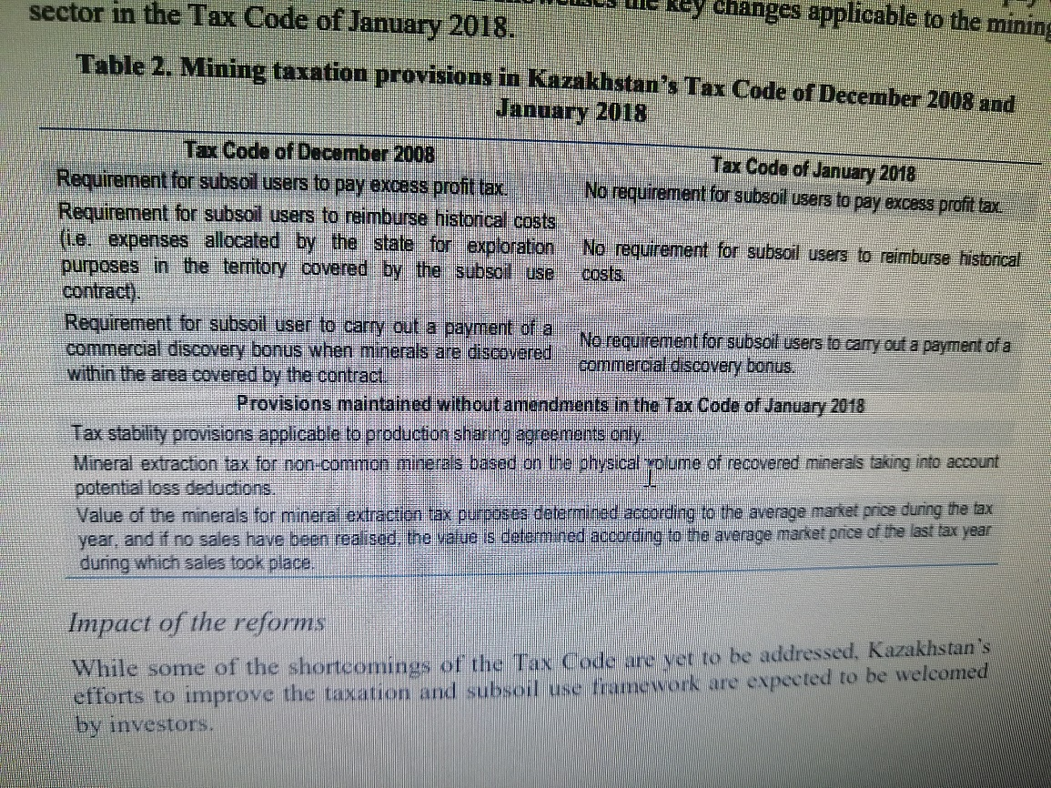

Slide 35
The requirement for mining operators to pay excess profit tax was abolished from the new Tax Code so as to encourage exploration and investment in the mining sector. While an excess profit tax can facilitate the state’s ability to capture economic rent from the mining sector, its design and administration can be challenging to manage (World Bank, 2014[2]) (Otto, 2017[52]). By removing the excess profit tax, Kazakhstan has reduced the tax burden on more profitable projects (which will please investors), and decreased the complexity of the fiscal regime therefore making it more appealing to investors and less burdensome for authorities to administer. The provisions requiring a reimbursement by the subsoil user of “historical costs” (i.e. expenses incurred by the state for exploration purposes in the territory covered by the subsoil use contract are allocated to investors) have also been removed from the new Tax Code. This also reduces the fiscal burden on investors, with the Kazakhstan Government now becoming a contributor to exploration costs

Slide 36
In addition, subsoil users are no longer obliged to pay a commercial discovery bonus when a discovery of minerals is made within the area covered by the contract. The removal of these bonuses also reduces the fiscal burden on investors, particularly in the early stages of projects where there is not yet cash flow from the mine. Given it is a “front-loaded” benefit to investors, it could have a significant positive impact on their investment plans. These reforms are aligned with the SSU Code which will require geological data to be published after a specified period. By expanding the stock of data available to analysts, this should also enhance the climate for exploration.

Slide 37
Chapter 85. TAX ON EXTRACTION OF MINERAL RESOURCES
Article 736. General provisions
1. the mineral extraction Tax is paid by the subsurface user separately for each type of mineral raw materials, hydrocarbons, underground waters and therapeutic mud extracted on the territory of the Republic of Kazakhstan.
2. the tax on the extraction of minerals for all types of extracted mineral raw materials, hydrocarbons, underground waters and therapeutic mud, regardless of the type of extraction carried out, is paid at the rates and in accordance with the procedure established by this Chapter.3. for the purpose of calculating the mineral extraction tax, the volume of minerals extracted from the written-off reserves (recovery of losses) for the field, as well as the volume of hydrocarbons, mineral raw materials, underground water and therapeutic mud transferred for technological testing and research, shall be excluded from the total volume of hydrocarbons, underground water, therapeutic mud and extinguished mineral reserves extracted during the tax period. The volume of hydrocarbons, mineral raw materials, underground water and therapeutic mud transferred for technological testing and research is limited to the minimum mass of technological samples specified in the national standards for the corresponding types (grades) of hydrocarbons, mineral raw materials, underground water and therapeutic mud.

Slide 38
Payers
Payers of the mineral extraction tax are subsurface users engaged in the extraction of hydrocarbons, mineral raw materials, underground waters and therapeutic mud, including the extraction of minerals from technogenic mineral formations for which the mineral extraction tax and (or) royalties have not been paid, within the framework of each individual concluded subsurface use contract, with the exception of subsurface users operating exclusively under the prospecting license.

Slide 39
Tax on production of useful minerals on mineral raw materials,with the exception of commonly occurring minerals
Объект обложения
Объектом обложения является физический объем запасов полезных ископаемых, содержащихся в минеральном сырье (облагаемый объем погашенных запасов).
Для целей настоящего раздела облагаемым объемом погашенных запасов является объем погашенных запасов полезных ископаемых, содержащихся в минеральном сырье, за вычетом объема нормируемых потерь за налоговый период.
Объем нормируемых потерь устанавливается на основании технического проекта разработки месторождения, утвержденного уполномоченным для этих целей государственным органом Республики Казахстан.
Для целей определения объекта обложения применяются единицы измерения, используемые в отчетных и сводных балансах запасов минерального сырья, предоставляемых уполномоченному органу по изучению и использованию недр.

Slide 40
Tax on extraction of mineral resources on widespreadminerals, underground water and therapeutic mud
The object of taxation is the physical volume of common minerals, underground waters, and therapeutic mud extracted by a subsurface user during the tax period.
For the purpose of determining the object of taxation, the units of measurement used in the reporting and summary balances of mineral reserves provided to the authorized body for the study and use of mineral resources are used.For the purposes of this Chapter, one cubic meter or one ton is considered to be the unit of volume of extracted common minerals and therapeutic mud.
Mineral extraction tax is not paid in the following cases:1) when re-pumping underground water into the subsurface (pumping man-made water) to maintain reservoir pressure;2) when dumping underground water (mine, quarry, mine), simultaneously extracted (simultaneously taken, pumped out) during exploration and (or) extraction of solid minerals;3) an individual engaged in the extraction of underground water on a land plot that belongs to him on the right of ownership, land use and other rights to land, provided that the extracted underground water is not used in the implementation of business activities;

Slide 41
Experience of the Republic Azebaijan
he main normative act in the Republic, governing relations in the sphere of subsoil use, the Law "On subsoil", adopted 13 February 1998, consisting of 7 chapters (General provisions, basis of use of mineral resources, rational use and protection of mineral resources, geological studies, government regulation of subsoil use relations, economic mechanism of subsurface use, responsibility for violation of the law), which brings together 48 articles.
For the first time in the history of Azerbaijan, its oil wealth belongs to the people. According to article 8 of the Law "On subsoil", a subsoil users in the Republic of Azerbaijan in the order established by the legislation can be legal and physical persons of the Azerbaijan Republic and foreign countries.
The rights and obligations of subsurface users arise from the moment when a special permission to use subsurface resources is obtained in accordance with the established procedure from the relevant Executive authority.The rights and obligations of subsoil users are set out in article 9 of the law. In particular, subsoil users have the right to use subsoil resources within the boundaries specified in the special resolution of the activity; independently select any not contrary to the legislation the activity on the subsoil plot in compliance with the purpose indicated in the special permission; to use the results of its operations, including extracted mineral raw materials, in accordance with the special permission and legislation; use mining waste, unless otherwise specified in the special permit; conduct geological exploration of the subsurface at their own expense without additional permits within the boundaries of mining allotments granted to them in accordance with the special permit; apply to the relevant Executive authorities that issued the special permit to review the conditions of the special permit in the event of circumstances that differ from those in which the special permit was granted.

Slide 42
CHAPTER VI. ECONOMIC MECHANISM OF SUBSURFACE USE
Article 39. Payment system for the use of mineral resourcesOn the territory of the Republic of Azerbaijan, the use of mineral resources is paid for, except for the cases provided for in article 44 of this Law.When using mineral resources, the following types of payments are made:state fee (fee) for issuing licenses;payments for the use of mineral resources;royalty;deductions for the reproduction of the mineral resource base;payments for the use of water areas and sections of the sea floor.In addition, subsurface users pay taxes and make other payments,provided by law

Slide 43
Article 40. Payments for the use of mineral resources
Subsurface users are charged for prospecting and exploration of mineral deposits.fossils. The amount of payments is determined as a percentage of the cost of work, and the procedure forthe collection of these payments is established by law. Payments for useful explorationmineral resources within the boundaries of the mining allotment provided to the subsurface user for miningthis mineral is not charged.Payments for mining are collected in accordance with the LawOf the Republic of Azerbaijan "On mining tax".Payments for excess losses during mining are charged in the amount ofand in the manner prescribed by law.Payments for the use of mineral resources for purposes not related to the extraction of minerals, inincluding for the construction and operation of underground structures, definedlegislation, depending on the size of the subsoil plot provided for use,useful properties of the subsurface and the degree of threat to the ecological balance in their useuse.

Slide 44
ON SUBSURFACE RESOURCES
10. Subsurface resources
1. the part of the earth's crust located below the soil layer, and in its absence - below the earth's surface, the bottom of reservoirs and watercourses, is considered to be Subsurface.
2. this Code regulates the use of mineral resources in relation to the following resources:
1) minerals;
2) technogenic mineral formations;
3) subsurface space.
Article 11. Ownership of mineral resources
1. in accordance with the Constitution of the Republic of Kazakhstan, the subsoil is state-owned.
2. the state provides the subsoil for use on the grounds, conditions and within the limits provided for by this Code.3. Actions of individuals and legal entities that violate the right of state ownership of mineral resources entail liability provided for by the laws of the Republic of Kazakhstan. Transactions concluded in violation of state ownership of mineral resources are void.

Slide 45
Minerals and their classification1. minerals are natural mineral formations and organic substances containing useful components, the chemical composition and physical properties of which allow them to be used in the field of material production and consumption directly or after processing.2. according to their economic significance and in order to establish appropriate conditions for subsurface use, minerals are divided into the following groups:
1) underground water;
2) hydrocarbon minerals (hydrocarbons);
3) solid minerals.

Slide 46
Hydrocarbons are recognized as crude oil, raw natural gas and bitumen.
Crude oil, gas condensate, and hydrocarbons obtained after refining crude oil and processing oil shale, oil-bituminous rocks, or resinous Sands are recognized as oil.Crude oil is any hydrocarbons, regardless of their specific weight, extracted from the subsurface in a liquid state at normal atmospheric temperature and pressure, including those formed from crude gas by natural condensation.Crude gas is any hydrocarbons, regardless of their specific weight, extracted from the subsurface in a gaseous state at normal atmospheric temperature and pressure, including untreated natural, associated, shale gas, coalbed methane, as well as non-hydrocarbon gases contained in them.
Associated gas is a multicomponent mixture of hydrocarbons and non-hydrocarbon gases that is in the composition of oil in a dissolved state under reservoir conditions and is released from it when the pressure decreases.Coalbed methane is a multicomponent mixture of hydrocarbons and non-hydrocarbon gases with a predominant methane content, which is in a gaseous state at normal atmospheric temperature and pressure, extracted from coal deposits.Natural bitumen is considered to be minerals of organic origin with a primary hydrocarbon base that lie in the subsurface in solid, viscous and visco-plastic States, the extraction of which in natural conditions by well methods is technically impossible.
4. solid minerals are natural mineral formations, organic substances and their mixtures that are in a solid state in the bowels or on the earth's surface.Solid minerals are divided into ore and non-metallic. Ore solid minerals are native metals, ores of ferrous, non-ferrous, rare, radioactive metals and rare earth elements. Other solid minerals are recognized as non-metallic

Slide 47
HOME TASKS
http://www.ijese.net/makale_indir/IJESE_1720_article_585ceee60cf23.pdf
https://www.sciencedirect.com/science/article/pii/S026483771931316X
https://prism.ucalgary.ca/bitstream/handle/1880/47048/Resources92-93.pdf?sequence=1
https://cyberleninka.ru/article/n/nekotorye-osobennosti-pravovogo-regulirovaniya-nedropolzovaniya-v-azerbaydzhane

